Slide 1

Project 4: Capstone
Presented by Leonard Choo

Slide 2
Agenda
Introduction
Exploratory Data Analysis
Modelling
Conclusion
Recommendation

Slide 3
Introduction

Slide 4
The Problem
Investing in startup companies can be risky due to ever changing market trends, management competency and technological advancement.
Predicting which startup companies have potential to make profitable returns can help investors make informed decisions on their investments.

Slide 5

Jason Lim
Age: 38
IT Project Manager
Pain Points:
Struggles to analyze IPOs due to limited time and financial knowledge
Easily swayed by social media hype and market sentiment

Slide 6

Priya Menon
Age: 42
Portfolio Manager at a Hedge Fund
Pain Points:
Pressure from partners to outperform benchmarks using IPO opportunities
Must prove that her IPO picks are backed by deep due diligence and unique insight

Slide 7

Daniel Koh
Age: 45
Senior Credit Risk Analyst at a Global Bank
Pain Points:
Needs to determine if the IPO proceeds will ensure company solvency
Must assess the sustainability of business models without full historical data

Slide 8
The Goal
Identifying IPOs that offer promising investment opportunities for investors seeking profitable returns, particularly after being publicly listed on the market and has at least a 250-million-dollar valuation before selling after 262 days.

Slide 9
Market Capitalization
Categories | Market Capitalization
Mega Cap | $200 Billion and greater
Big Cap | $10 Billion to 200 Billion
Mid Cap | $2 Billion to $10 Billion
Small Cap | $250 Million to 2 Billion
Micro Cap | $50 Million to $250 Million
Nano Cap | Under $50 Million

Slide 10

Initial Public Offering (IPO)
When a privately held company offers shares to the public for the first time, allowing it to raise capital and become publicly traded.
Median as Average
The median is often preferred over the mean when a dataset contains outliers or is skewed. The mean, being sensitive to extreme values, can be pulled away from the true center of the data.

Slide 11
Assumptions
Include only companies with at least 250-Million-dollar valuation
Based on US market only
All sectors included
Limitations
Missed out potential high growth nano and micro-cap IPO companies
Missed out potential high growth IPO companies from some other markets
Might not be great as technology sector grows/fails faster than other sectors

Slide 12

Success Criteria: Price Gain Ratio > 1
$$Price Gain Ratio=\frac{ Day 261 opening price}{Day 0 opening price}$$
If Price Gain Ratio > 1, profitable after 262 days.
If Price Gain Ratio < 1, unprofitable after 262 days.

Slide 13
EDA

Slide 14

Dataset
484 Companies
15 Countries
12 Sectors
1996 to 2017 Period
With 485 rows and 37 columns

Slide 15
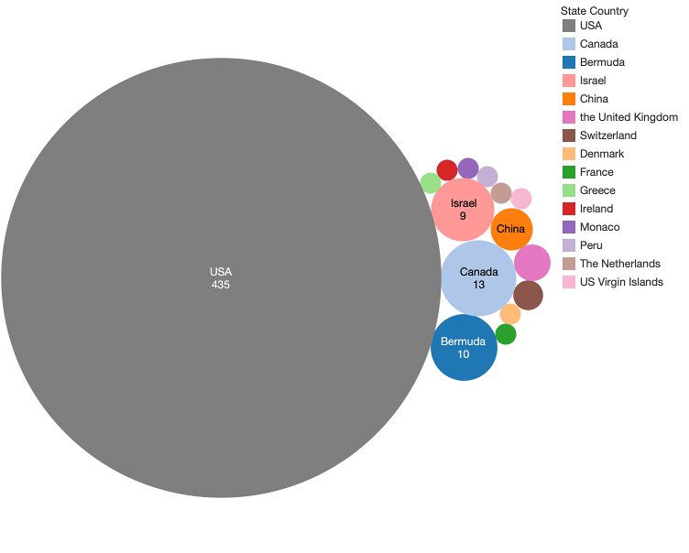
Countries
USA has the most companies in the US market of 435, with the next biggest being Canada of 13 companies.

Slide 16
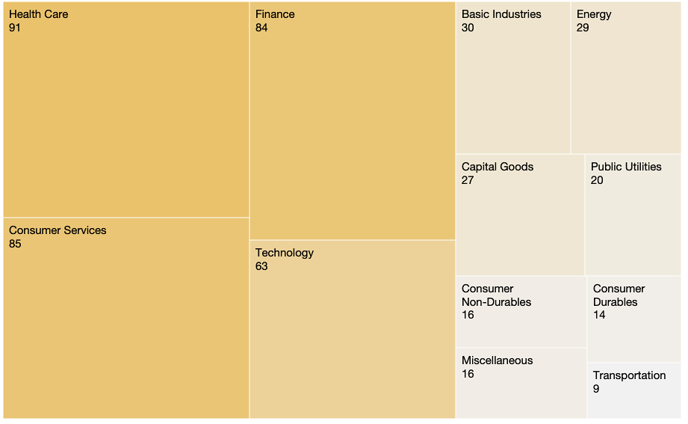
Sector Groups
Health Care, Consumer Services and Finance Sector contains the most companies with Transportation being the lowest.

Slide 17
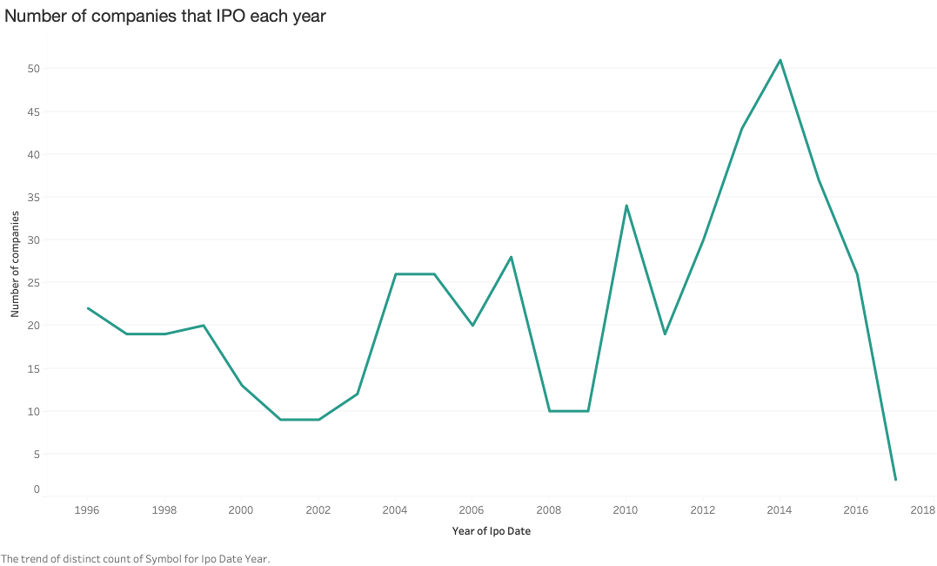
In 2014, the number of companies that IPO, peaked at 51 but dropped sharply after that.
Notes:
Conflict in Ukraine, ISIS Emergence, West African Ebola Outbreak

Slide 18
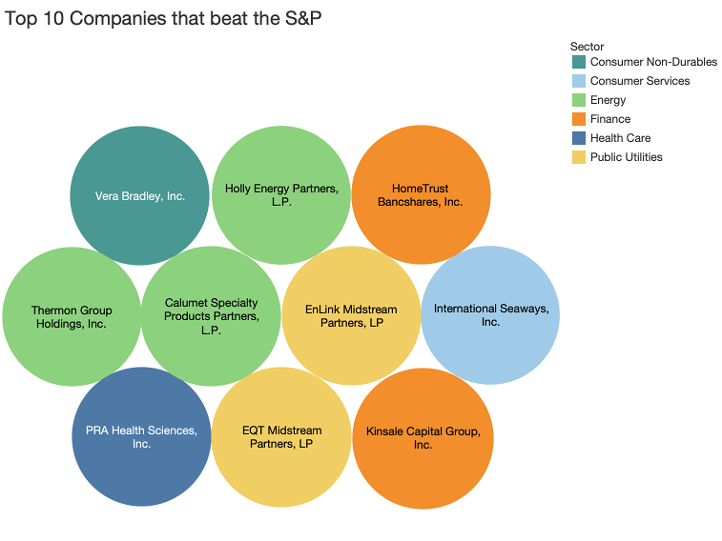

Slide 19
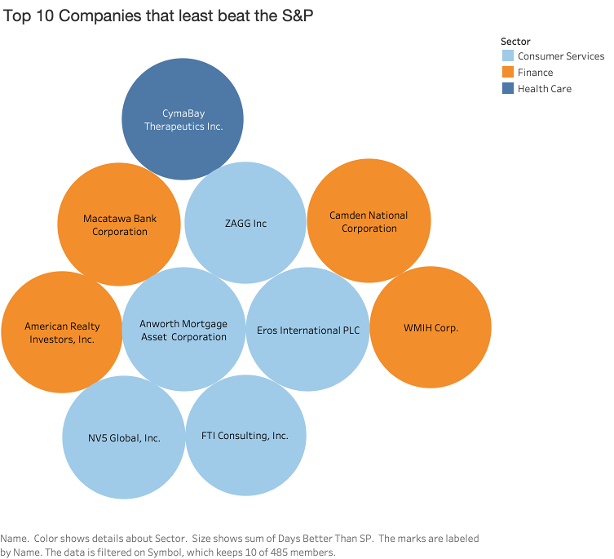

Slide 20
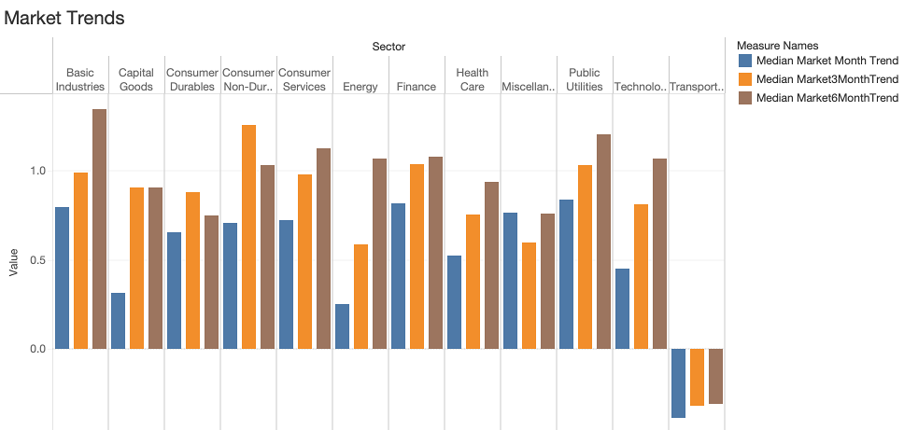
Market Trends
Companies in the transportation sector experience negative median market month trends over the 6 months since their IPO.

Slide 21
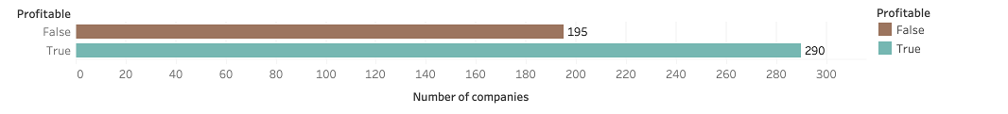
Profitability
59.8% of companies are profitable after 262 days on being on the stock market.

Slide 22
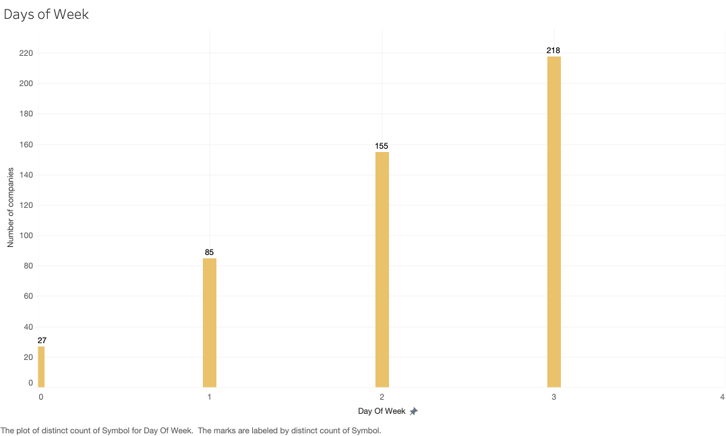
Day of the week
The most popular day of the week to IPO is on Thursday, with 0 companies that IPO on a Friday.
Monday
Tuesday
Wednesday
Thursday
Friday

Slide 23
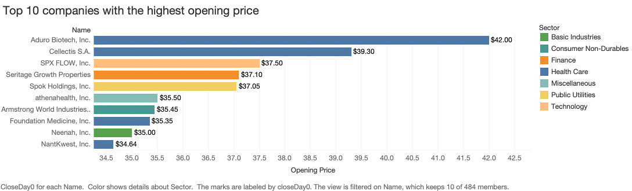
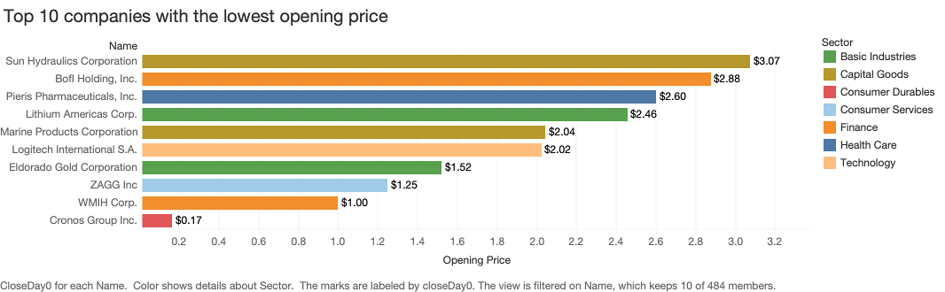
Opening Prices
4 companies come from the healthcare sector.
Highest price: Aduro Biotech
Lowest price: Cronos Group
Average opening price: $15.13

Slide 24
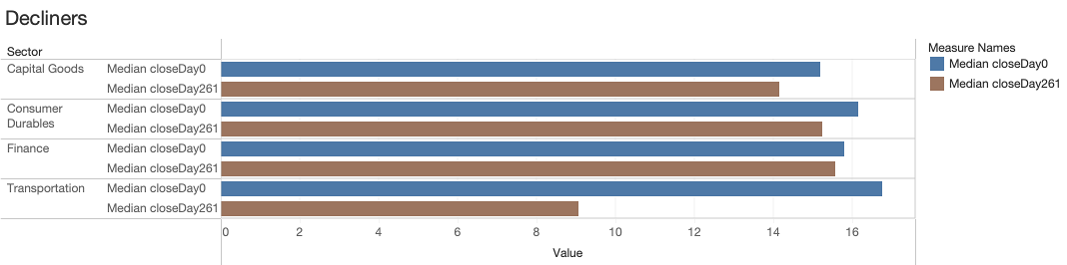

Slide 25
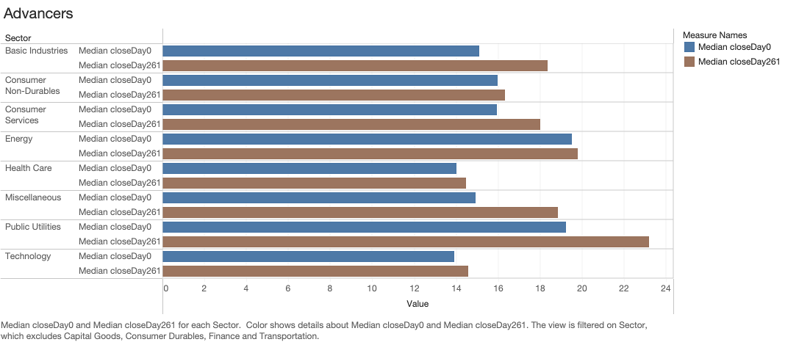

Slide 26
Correlation
Column Name | Correlation
daysProfit | 0.704692
Profit_Ratio | 0.546951
closeDay261 | 0.481725
DaysBetterThanSP | 0.349080
closeDay179 | 0.299088
netIncome | 0.139873
Year | 0.103277
MarketCap | 0.102705
employees_x | 0.100750
closeDay6 | -0.103770
Market3MonthTrend | -0.106430
volumeDay0 | -0.113906
Market6MonthTrend | -0.114429
MarketMonthTrend | -0.120170
closeDay0 | -0.129045
Notes:
Correlation helps determine if changes in one variable are associated with changes in another, which ranges from -1 to +1, indicates the strength and direction of the relationship.
After finding the correlation of the features to what stocks are profitable, these are the 13 features that are chosen.

Slide 27
3 Prediction Models
 | K-Nearest Neighbors | Decision Tree | Logistic Regression
Accuracy | 0.844 | 0.877 | 0.893
Predicted Profitable | 43 | 46 | 44
Predicted Non-Profitable | 60 | 61 | 65
False Positives | 8 | 7 | 3
False Negatives | 11 | 8 | 10
Logistic Regression (highest accuracy: 89.3%

Slide 28
Logistic Regression is chosen for balanced and reliable predictions of profitable stocks.
Notes:
It gives a strong overall performance and avoids the costliest errors without sacrificing too many opportunities.

Slide 29
Feature Importance
Rank | LR Features | Feature Importance
1 | daysProfit | 1.470206
2 | closeDay6 | 1.295600
3 | DaysBetterThanSP | 0.658048
4 | closeDay179 | 0.557961
5 | closeDay0 | 0.410486
6 | netIncome | 0.314902
7 | MarketCap | 0.191450
8 | Year | 0.175671
9 | Market6MonthTrend | 0.147758
10 | MarketMonthTrend | 0.139165
11 | Market3MonthTrend | 0.094513
12 | volumeDay0 | 0.073432
13 | employees_x | 0.051647

Slide 30
Recommendations
1. Avoid investing in companies in sectors like Capital Goods, Consumer Durables, Finance and Transportation.
2. Investing in companies in sectors like Basic Industries, Consumer Non-Durables, Consumer Services, Energy, Health Care, Miscellaneous, Public Utilities and Technology.
3. Use Logistic Regression to predict if a stock is profitable or not
Notes:
Logistic Regression
Decision Tree
K-Nearest Neighbors (KNN)
Linear
Non-linear, tree-based
Non-parametric, instance-based
Assumes linear relationship between input features and log-odds of the target
No assumptions; works well with complex data
Assumes similar instances are close in feature space
Fast (solving optimization)
Fast (greedy splitting)
Very fast (no training needed)
Fast
Fast
Slow (needs to compute distances to all training samples)
Good for linear problems, poor with complex patterns
Good with non-linear and interaction-heavy data
Good for small datasets; sensitive to irrelevant features

Slide 31
Jason Lim
Age: 38
IT Project Manager
Pain Points:
Struggles to analyze IPOs due to limited time and financial knowledge
Easily swayed by social media hype and market sentiment

Slide 32
Priya Menon
Age: 42
Portfolio Manager at a Hedge Fund
Pain Points:
Pressure from partners to outperform benchmarks using IPO opportunities
Must prove that her IPO picks are backed by deep due diligence and unique insight

Slide 33
Daniel Koh
Age: 45
Senior Credit Risk Analyst at a Global Bank
Pain Points:
Needs to determine if the IPO proceeds will ensure company solvency
Must assess the sustainability of business models without full historical data

Slide 34
Thank You

